Slide 1
Statistics for Public Health Research
Center for Data Research and Analytics
Session 1: Research question, Population, and Sample

Slide 2
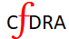
Session-1 Table of Content
Population and parameters
Sample and Estimators
Research question
Quantification of a research question
Measuring the disease outcome
Random sample
Source of biases in sampling

Slide 3
Population
The population is the complete collection of similar objects, items, or events
In a population, objects are comparable in terms of some characteristics
Example: Males of Bangladesh, all trees in Bangladesh.
Researchers define a population. Definition of population varies by the objectives of a research
A population may vary by time and space. In that case, to define a population, a researcher should explicitly specify the time and place.
For example, females of Bangladesh, 2021.
Each object included in the population is a study unit. We call it a subject or study subject.
For the male population in Bangladesh, a male is a subject.

Slide 4
Parameter
The parameter are the measurable characteristics of subjects in a population
For example, the average monthly income of females in Bangladesh, 2021.
Research aims to know those measurable characteristics (parameters). A known parameter helps us to make decisions about the population.
For example, the number of cancer patient in Bangladesh could help us to plan for adequate cancer care setup in Bangladesh.
A kid garment industry needs an information about the weight distribution of children <5 in Bangladesh.
Parameters are unknown constants that specifies the population

Slide 5
Research Question
The very first step of a scientific research method
A research ask questions about the parameter of a population
For example, what is the prevalence of cancer among people in Bangladesh
What is the yearly trend in cancer reporting in government facilities in Bangladesh
A question comes from the primary observations about the population
It is researcher's primary role to pose a research question. A statistician/biostatistician can help you define the study population, quantify the parameter, and restate your research question to proceed forward.
Next couple of slides we have introduced a few research questions and their relevant study populations and parameters

Slide 6

Population Example
Research Questions
What is the level of CO₂ concentration in the atmosphere in 2021
What causes CO₂ concentration increase over the last 10 years in the atmosphere?
The world atmosphere is the population and level of CO2 is the parameter of the for these research questions.

Slide 7
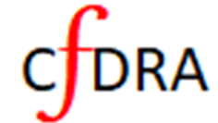
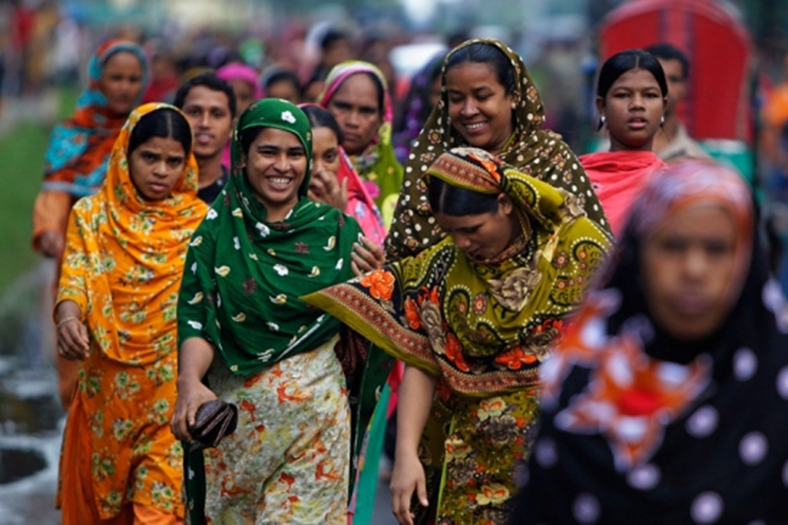
Population Example
Research Questions
What is the prevalence of breast cancer in Bangladesh in 2021
What are the main causes of breast cancer among women over age 40 in Bangladesh
The population consists of all females in Bangladesh who are at risk of breast cancer until 2021. The prevalence, underlying causes are the parameter.

Slide 8

Population Example
Research Questions
What is the prevalence of prostate cancer in Bangladesh?
What is the risk of prostate cancer among Bangladeshi males?
What are the risk factors for the prostate cancer?
Which age male are at most risk of prostate cancer in Bangladesh?
The population consists of all males of Bangladesh who are at risk prostate cancer. The average age at which males get prostate cancer is a parameter

Slide 9
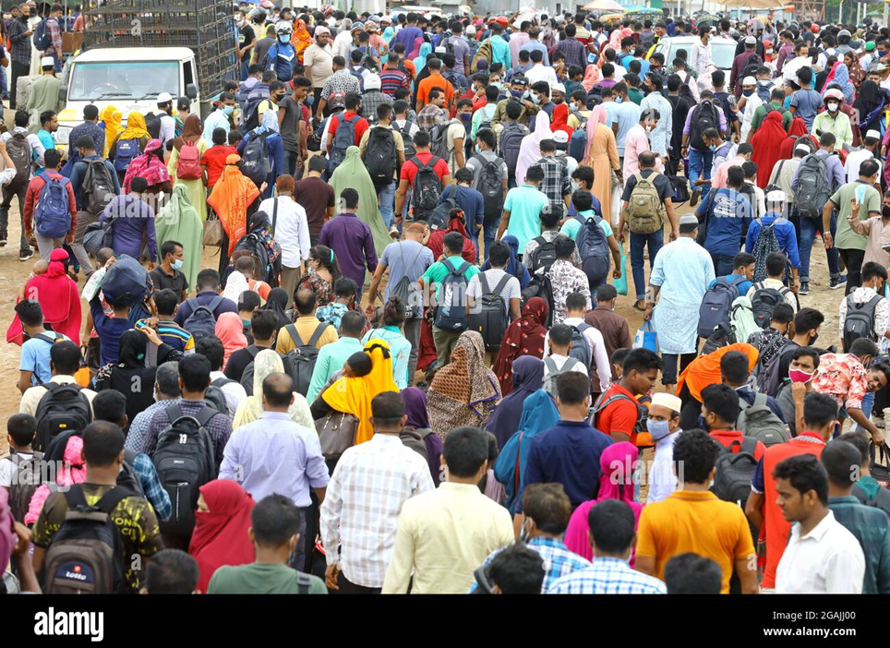
Population Example
Research Questions
What is the COVID-19 incidence rate in Bangladesh in 2021
What is the risk factors for COVID-19 infection in Bangladesh
Which age group is most likely to get COVID-19 in Bangladesh
How many people are need to be vaccinated to control the spread of COVID-19 in Bangladesh
The population consists of all people in Bangladesh who are at risk of COVID-19

Slide 10

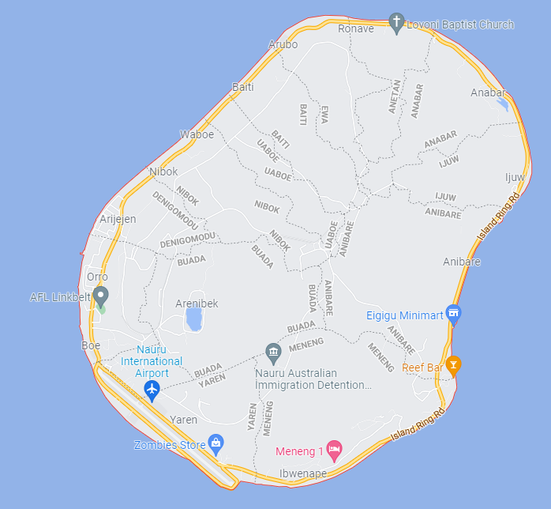
Research Problem
Nauru is an independent island country
Area: 8 Sq. miles
Population: 11,000
Female population approx. 6,000
Female >25 years of age is about 3,000
RQ: what is the number of breast cancer patients in Nauru?
What will be your population?
What is the parameter?

Slide 11
Research Problem
Female >25 years of age is population. This age group female were at risk of breast cancer
There exists an X number of breast cancer patients in Nauru. X is the parameter.
We want to know the X
Reach 3,000 females, test them for cancer, and count the number of positives.
Answering research question is easy if the whole population is known.
Notes:
Try a research question within a completely accessible population. Provide a solution for your research question. Use the github discussion page to write and share.

Slide 12
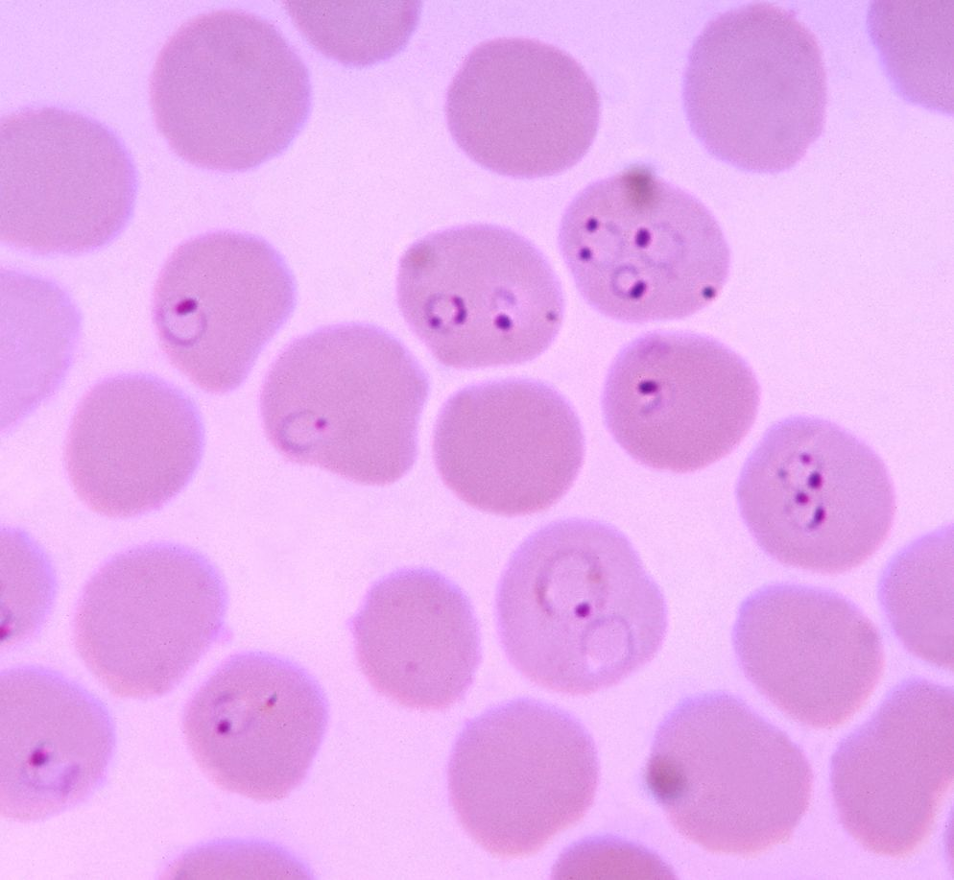
Research Problem
A patient is suspected of malaria
What percentage of patients red blood cell (RBC) that are infected with malaria parasites
The percentage is the parameter that would help the doctor to decide the dose of the medication
The whole blood that the patient have in his/her body is the population
We cannot get the true parameter
Malaria parasites within the RBCs
Population can be of infinite size. We often don’t have access to the whole population. Still, we need the parameter for decision making
Notes:
Try a research question for an infinitely large population. Provide a solution for your research question. Use the github discussion page to write and share.

Slide 13
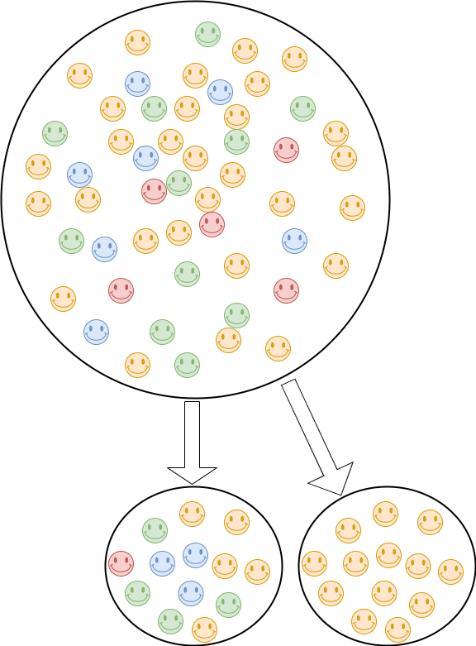
Sample
In Statistics, a sample is a representative part of a population
For example, blood sample drawn from a malaria patient
Getting a representative sample may not be easy. Sampling methods in statistics handles the issue
We estimate (not determine) the parameter from the sample and generalize the estimate on the population
The sample size n determines the consistency of the estimate. As n grows until the population size, the estimate becomes precisely the parameter.
We try to reach the population through representative samples generated from the population.
Population
Representative Sample
Biased Sample
Estimates from a biased sample might not be generalizable to the population
Notes:
Give an example of a biased sample based on your research question and population.

Slide 14
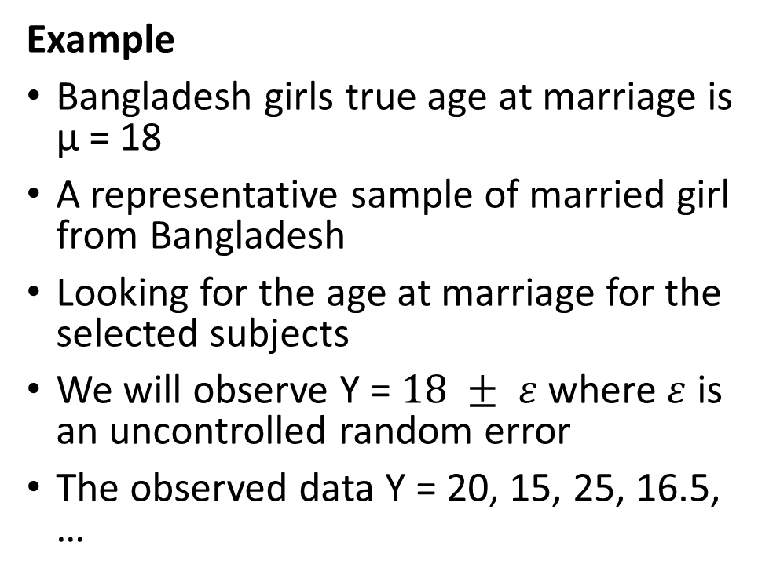
Data for Parameter
There exist the true parameter in the population
When we collect data from the population/sample, (philosophically) that parameter generates the data
Data carries the information about the parameter and the uncontrolled error
Error are expected to be random
Subjects' data stored systematically under a variable say (Y).
Example
Bangladesh girls true age at marriage is µ = 18
A representative sample of married girl from Bangladesh
Looking for the age at marriage for the selected subjects
We will observe Y = $18 ± ε$ where $ε$ is an uncontrolled random error
The observed data Y = 20, 15, 25, 16.5, …
Data includes measurement of parameter in a subject. The parameter of the population is the center to generate data.

Slide 15
Nominal Variable
A number is assigned to describe an attribute or characteristics
Eye color: 1 = black, 2 = brown, and 3 = others
Patients' division: 1 = Dhaka, 2 = Chittagong, 3 = Rajshahi, 4 = Khulna, 5 = Rangpur, 6 = Sylhet
There is no concept of order. Variables that measured in the nominal scale are a qualitative/categorical variable
Tables or charts commonly used to present data
Common statistics such as proportion, percentage are used to analyze categorical variables measured in the nominal scale
Binary variable is a special case of nominal however, 0, 1 is used for presence of absence of something.
Notes:
Give few examples of nominal variable that you have ever used in your research

Slide 16
Ordinal Variable
An ordinal variable is a categorical variable and there is a concept of order in those values. The distance between values might not be the same
Example: Educational level might be categorized as
1: No formal education
2: Primary
3: Secondary
4: higher Secondary
5: Graduate
6: Post-graduate
In this example the difference between category 1 and 2 is not the same as 5 and 6 in terms of education, or time.
Careful attention is required for any statistical or numerical procedure. For example, average educational level of 3.5 might not be meaningful unless explicitly defined
Notes:
Give few examples of ordinal variable that you have ever used in your research

Slide 17
Interval variable
The interval variable takes values from a scale where each point placed at an equal distance from one another.
There is no concept of zero (absent)
These arithmetic operations are, however, just limited to addition and subtraction.
Examples of Interval Variable
Temperature: Temperature, when measured in Celsius or Fahrenheit is considered as an interval variable.
IQ Test: A subject IQ cannot be zero, therefore satisfying the no zero property of an interval variable. The level of IQ determines, which interval the score she/he falls in.

Slide 18
Ratio Variable
The ratio variable are variables that are measured in the ratio scale
The ratio variable has an absolute zero that indicates the absence of something
Mathematical operations such as addition, subtraction, multiplication and division is possible
It has an intrinsic order with an equidistant scale.
All statistical analysis including mean, mode, median, etc. can be calculated on the ratio scale.
Weight, height can be measure in this scale
Notes:
It seems difficult to differentiate between interval and ratio scale, while using the scale for the measurement, keep in might how you will deal with the zero.

Slide 19
Measuring an outcome/disease
All measurement involves a measurement scales. Choice of a scale depends on how we want to answer our research questions. For example, breast cancer can be evaluated as follows:
Perform a diagnostic test. Positives will receive 1 otherwise 0. (Binary/nominal)
Positives could be further detailed (ordinal scale)
The tumor is graded, and cancer is staged for a cancer patient. Cancer has 4 stages (I, II, III, and IV) and 4 different tumor grades (1, 2, 3, and 4)
Positives even further detailed (ratio scale)
Size/volume of the tumor [0, infinity)
Level of pain due to cancer
on the scale of -5(no pain) to 5 (extremely painful)
[-5, -4, -3, -2, -1, 0, 1, 2, 3, 4, and 5]
Notes:
Try it on you on outcome of interest

